Slide 1
Meet the teacher
2024 - 2025

Slide 2
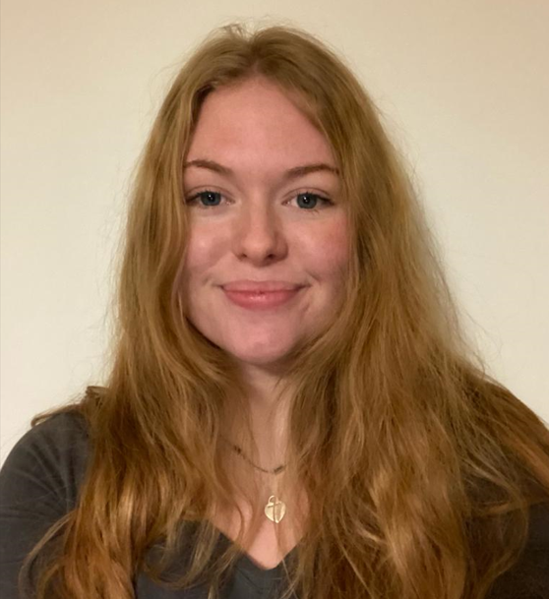
Year 3 teachers
Miss Simonett

Slide 3
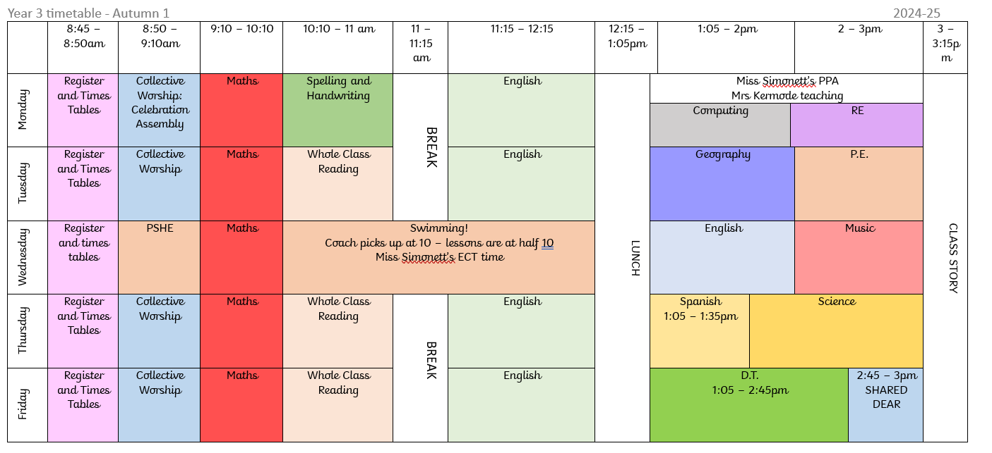
Timetable

Slide 4
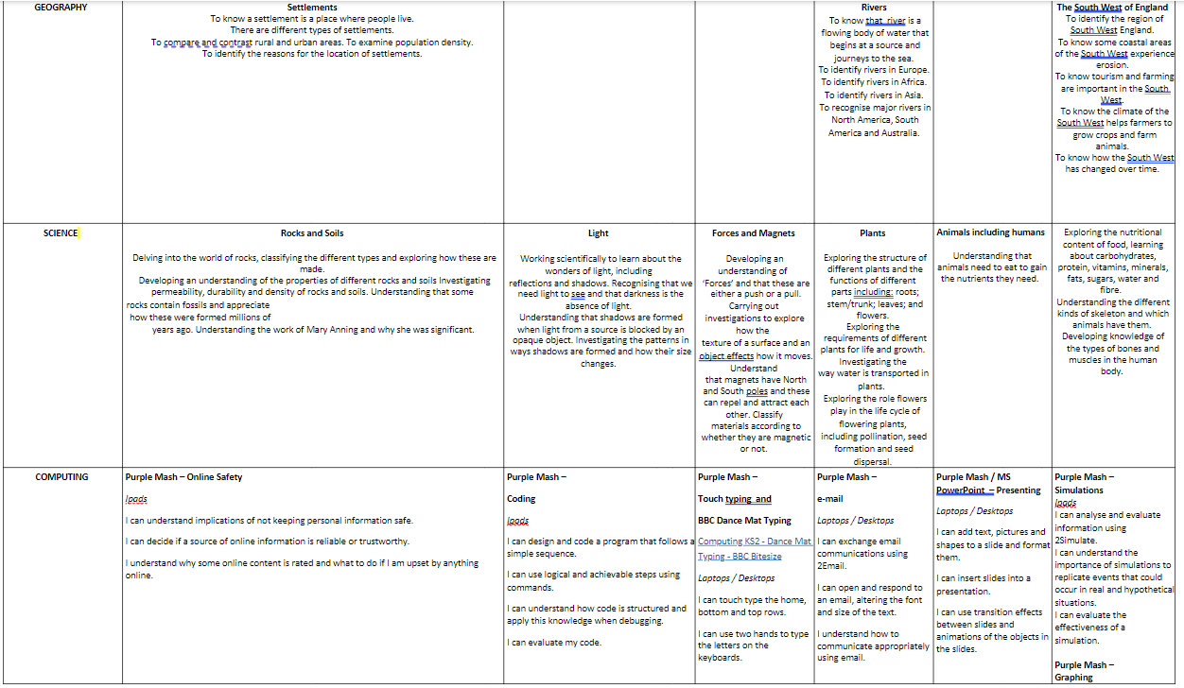
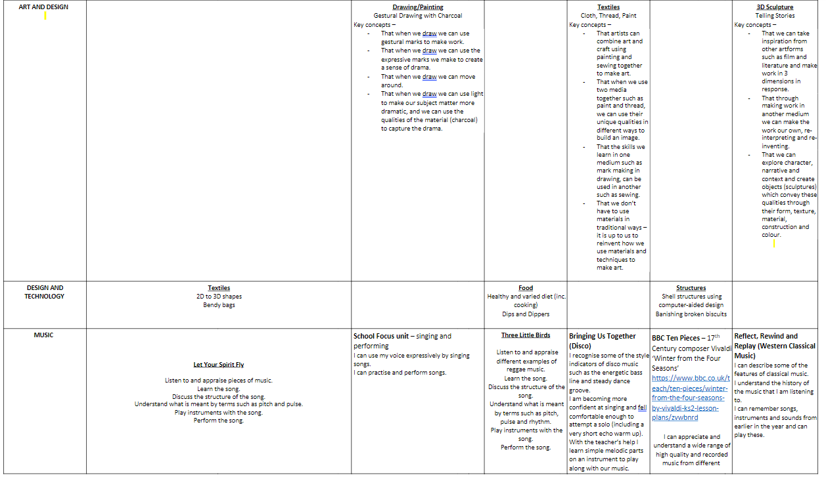
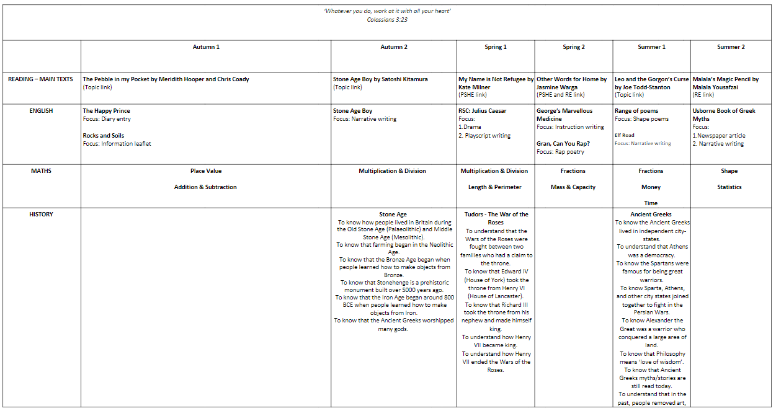
Curriculum Overview

Slide 5
Home Learning
Reading – we continue to focus on reading throughout the whole school. Reading diaries will be checked weekly. Children are expected to read the books they are given as we has assessed their level as well as having the option to bring in books from home to read.
Maths/ English - this will also be linked to what is taught in class. This will be sent on a Friday and is due back the following Friday. The homework will alternate between maths and English weekly.
Spelling – these are sent out on Mondays and tested the following Monday. They will also be put on ClassDojo. During the of the year, we may also send out further spelling work as intervention.
TTRS – children are expected to practice their times tables regularly using TTRS. This will also be checked on a Friday to see who have been using it.

Slide 6
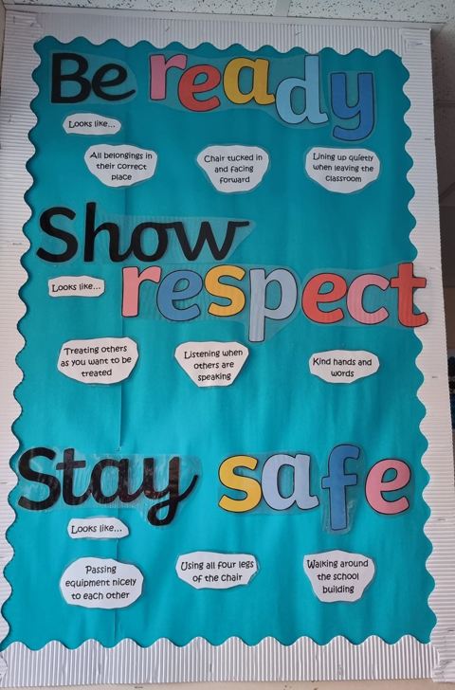
Ready, Respectful, Safe
In school, talk about behaviour that falls under Ready, Respectful and Safe.
In class, those children who consistently act as role models, focus in lesson time and try their best will be awarded Dojo points.
These points are accumulated by house teams over half-terms and rewards give to the winning team at the end of the half-term.

Slide 7
Ows wows and nows
In school we are also focusing on the ows, wows and nows. Throughout school you will see displays which should have further pictures, or notes or work which celebrate our wows.
This may include self reflection, critical thinking and further good work!
If you have any wows or nows you would like to share so we can include this in the classroom – Please send them to me and I will be sure to highlight the positivity in our classroom!

Slide 8

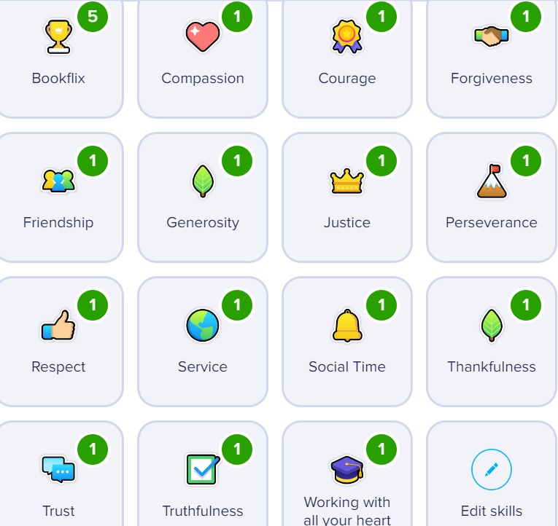
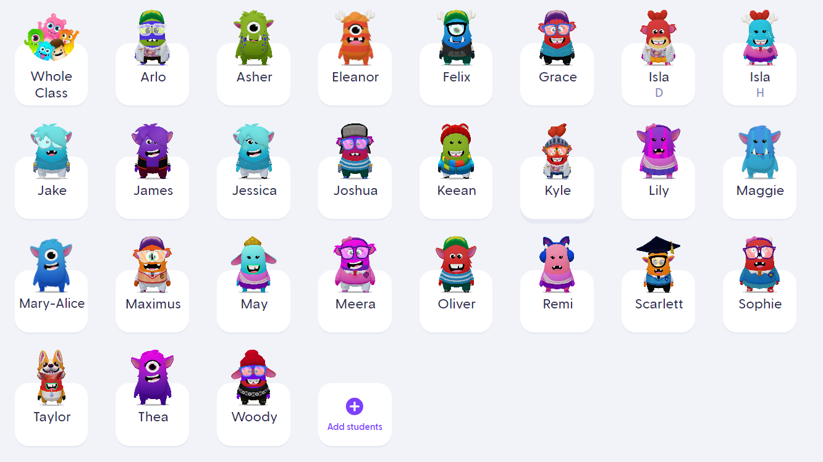
Class Dojo

Slide 9
Information Points
If you need any further information about what we are doing in class, our timetable or other information, the class page is the first place to check.
https://www.longitchington.covmat.org/swift-class-year-4-2/
Email school.parents@longitchington.covmat.org if you need to ask me a question and the website does not have the answer. There is also Class dojo if there is any queries. Please note these will not usually be checked after 4pm.

