Slide 1

Meet the teacher
2024 - 2025

Slide 2
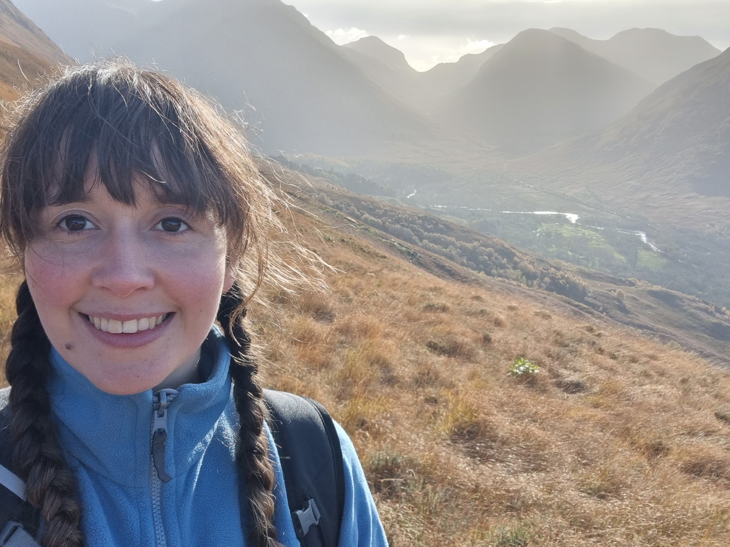
Year 2 teacher
Miss Kerry
History Lead
Music Lead
Teaching Assistants
Miss Brown
Mrs Laycock

Slide 3
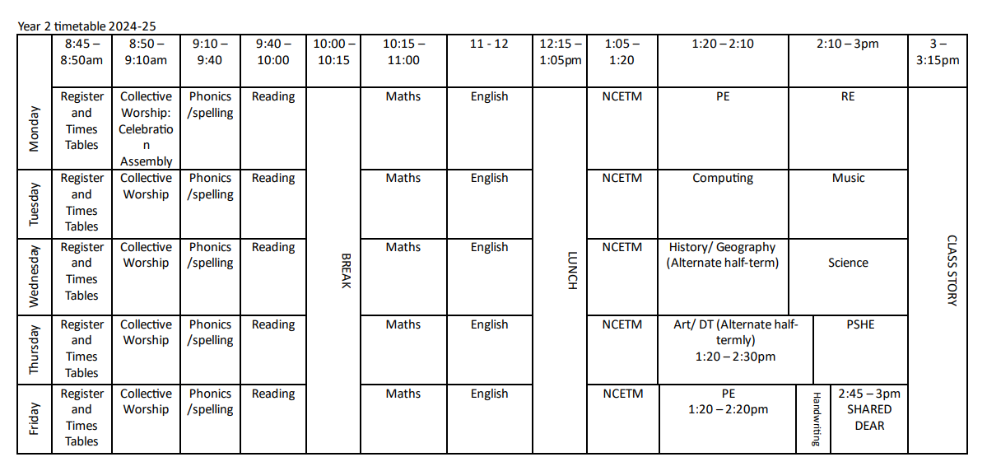
Timetable

Slide 4
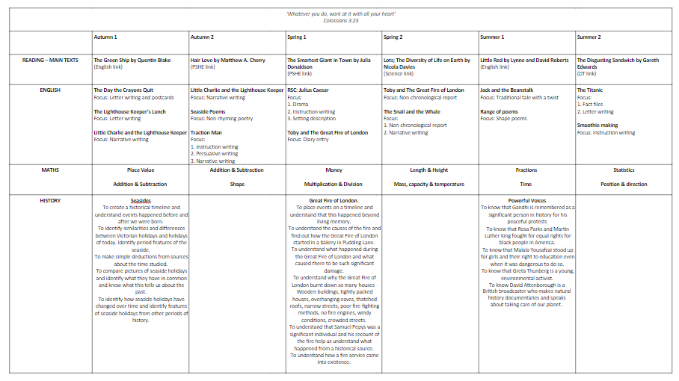
Curriculum Overview

Slide 5
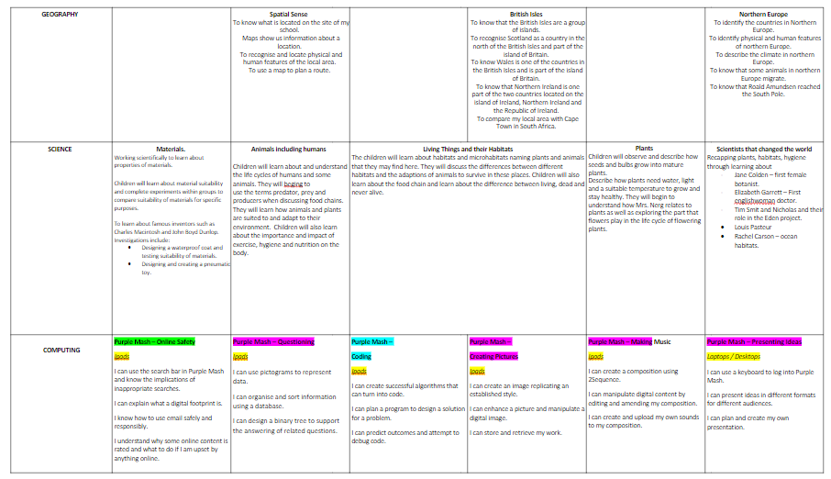
Curriculum Overview

Slide 6
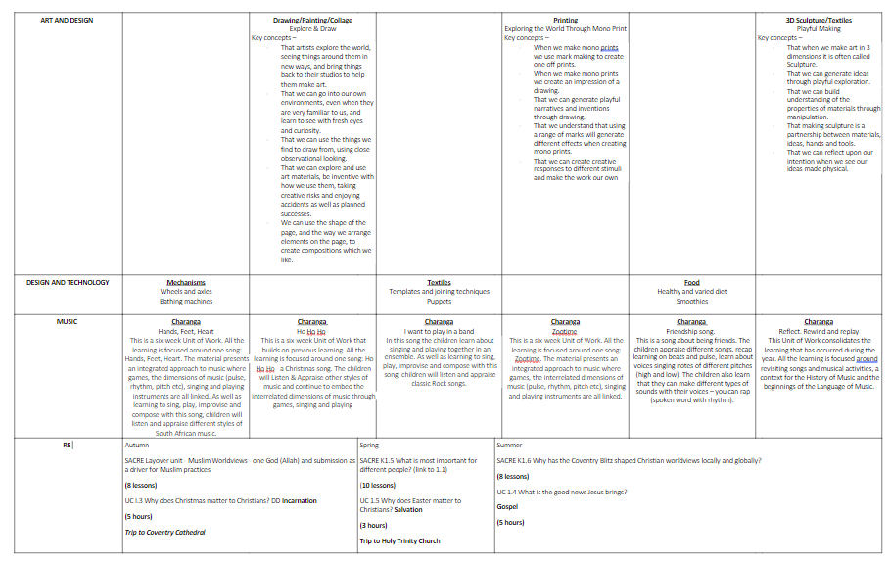
Curriculum Overview

Slide 7
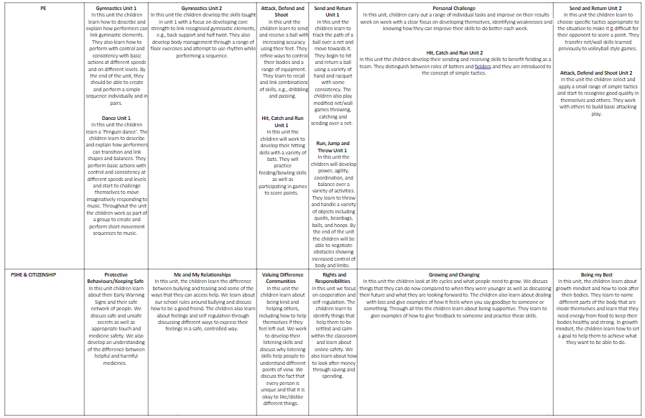
Curriculum Overview

Slide 8
Home Learning
Reading – Please could children read at least 3 times at home but aim for 5. Reading is the key to understanding so much of their learning. Reading diaries will be checked each week and dojos and stickers awarded to children reading at home.
Maths/ English - this will also be linked to what is taught in class. This will be sent on a Friday and is due back the following Friday.
Spelling – these are sent out on Fridays and due back the following Friday. These spellings will be tested the following Monday.

Slide 9
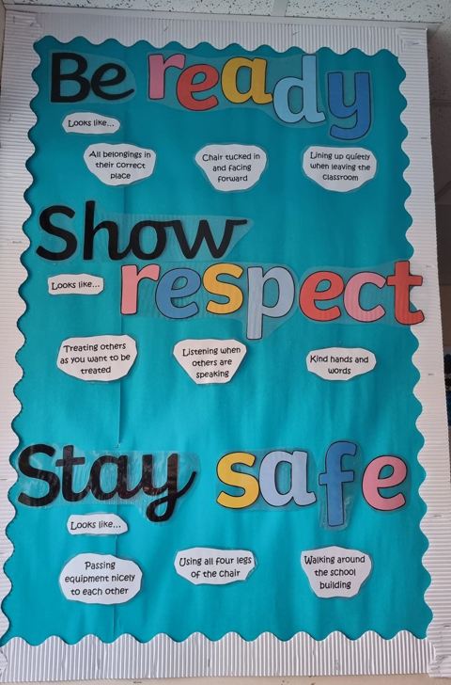
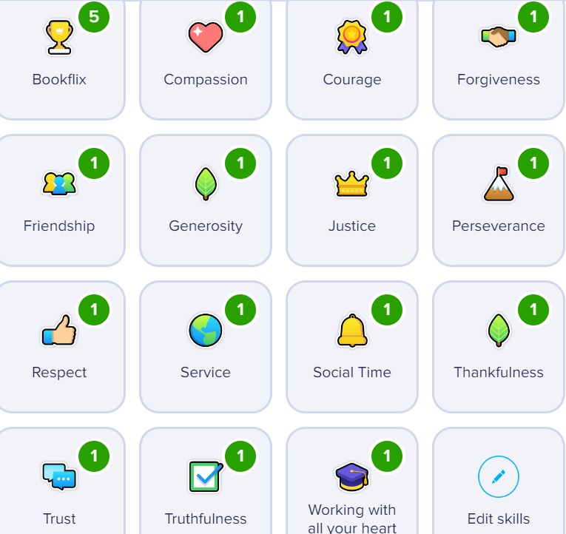

Ready, Respectful, Safe
In school, talk about behaviour that falls under Ready, Respectful and Safe.
In class, those children who consistently act as role models, focus in lesson time and try their best will be awarded Dojo points. I hand out certificates each Friday to my top scoring Dojo champions!
Class Dojo

Slide 10
Information Points
If you need any further information about what we are doing in class, our timetable or other information, check on Class Dojo or the school website.
Email school.parents@longitchington.covmat.org if you need to ask me a question and the website does not have the answer. I only check my emails between 8am and 4:30pm. Any emails sent over 4:30pm will be picked up the following day.
You are also more than welcome to send me a message on Class Dojo which I will respond to when I can.

